Slide 1
What Makes a Hit?
Examining the Billboard Top 100 since 1965
Sylvia Ayikpah, Christina Ling, & Charles Naylor

Slide 2
Executive Summary
Lyrics Breakdown into 2 Categories
  Love/Heart Break Song
  Non-Romance Song
Major Rising Factors
  Pop
  Loudness
  Energy

Slide 3
Research Objective
Using data from Spotify, Last.FM, and Kaggle, we examined details of the Billboard Top 100 songs for the last several decades.
Are there any clusters of similar songs?
How did hit songs change over time?
Were there killer lyrics that put a song over the top?

Slide 4
Research Plan and Methodology
We gathered data from:
Kaggle Billboard Top 100 dataset
Last.fm API (for genre tags)
Spotify API (for song characteristics)
We used this data to conduct cluster analyses, look at historical trends in songs, and predict future song rankings. We used:
K-Means and Gower Dissimilarity Clustering
Trend
Logistic Regression

Slide 5
Data Findings
Spotify Clusters
Trends
Best Lyrics
Predictions

Slide 6
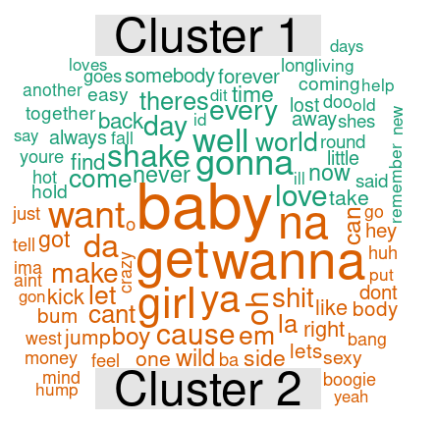
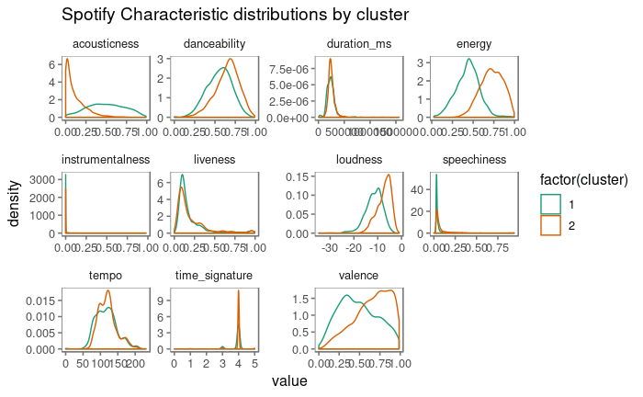
Spotify Clusters - 2
Typical Lyrics by Cluster

Slide 7
Lyrics Cluster - 2
Cluster | Count | Girl | Love | Ooh | Want | Baby | Yeah | Back
1 | 1103 | 2.346 | 8.451 | 1.068 | 2.642 | 5.119 | 2.838 | 1.343
2 | 3997 | 0.604 | 1.683 | 0.285 | 0.925 | 1.031 | 0.852 | 0.667
Average Word Frequency
Cluster 1 - Love/Heart Break Songs
Cluster 2 - Non-Romance Songs

Slide 8
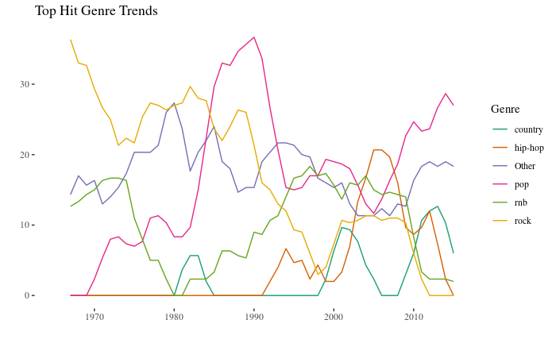
Trends - Genres
Rock in long, slow decline
Hip-hop is over
Pop is king again
Occasional interest in Country

Slide 9
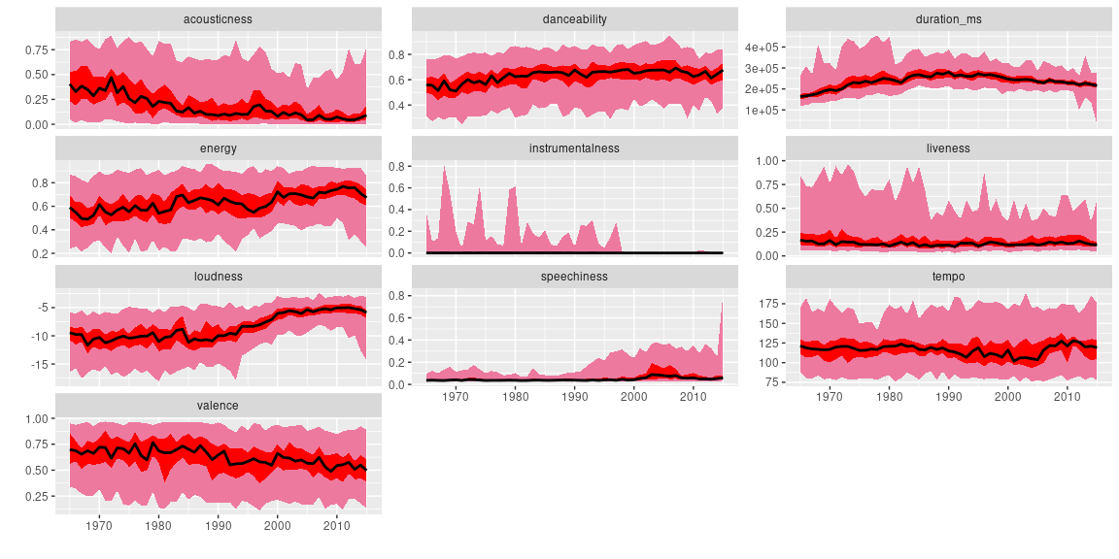
Trends - Spotify
Songs are getting:
Louder
Shorter
Sadder
Distributions of Scores

Slide 10
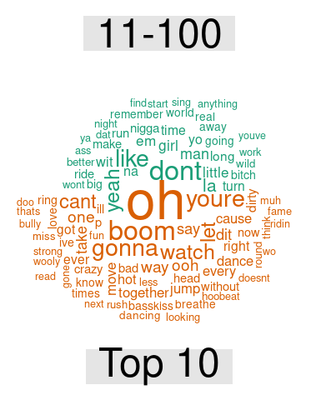
Most Popular Lyrics
Songs in the Top 10 vs the Rest

Slide 11
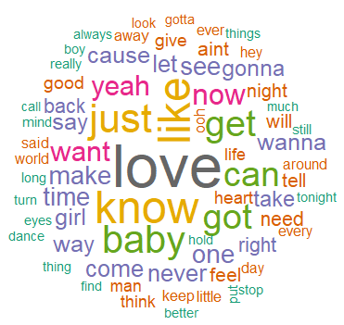
Predictions - Logit
Word Used:
Used only past 7 year to train the model
Predicted 2015
P R E D I C T E D | Actual
 |  | Top 10 No | Top10 Yes
 | No | 88 | 8
 | Yes | 2 | 2
90% Hit Rate

Slide 12
Conclusions
Many different type of songs can be a hit
There are still broad, identifiable trends in music

Slide 13
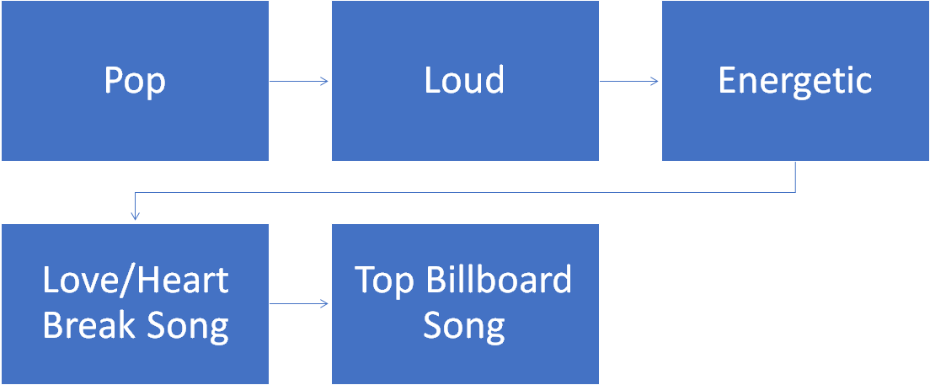
Recommendations

Slide 14
Appendix

Slide 15
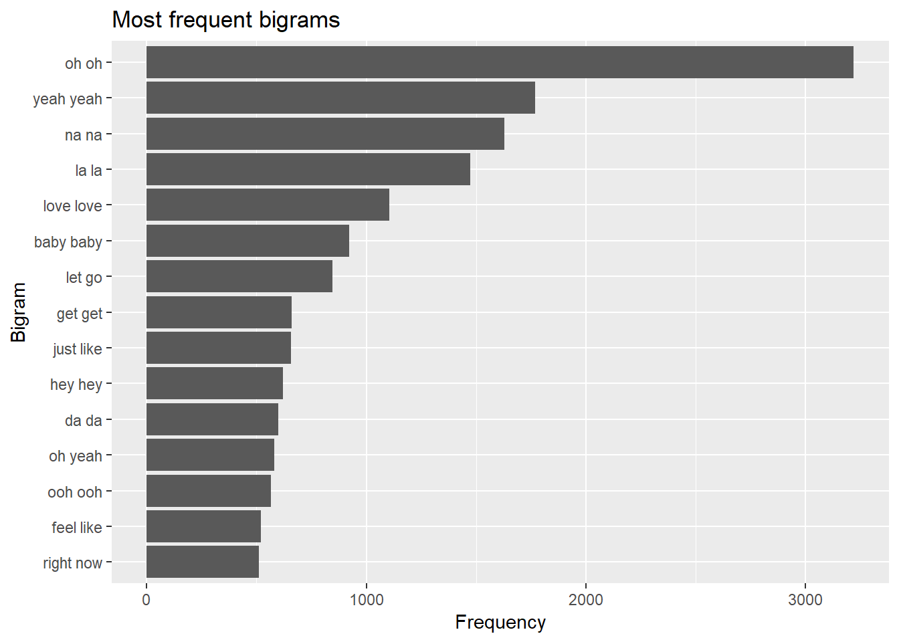
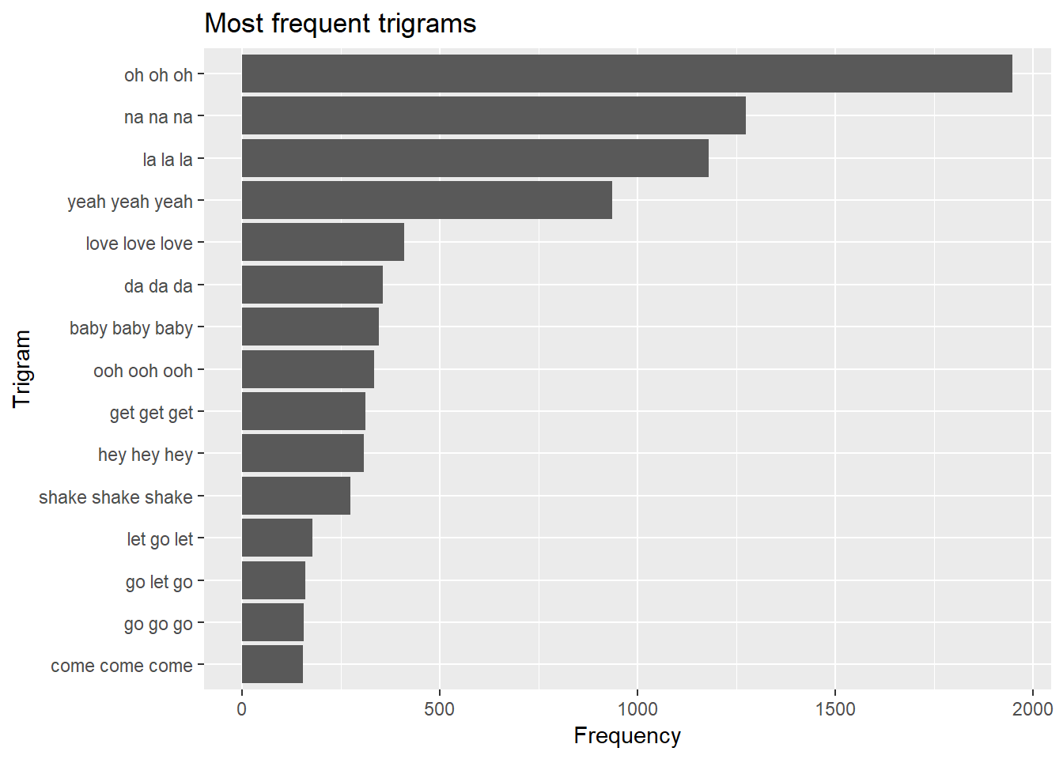
Other Word Trends - Bigrams & Trigrams
Repeating words

Slide 16
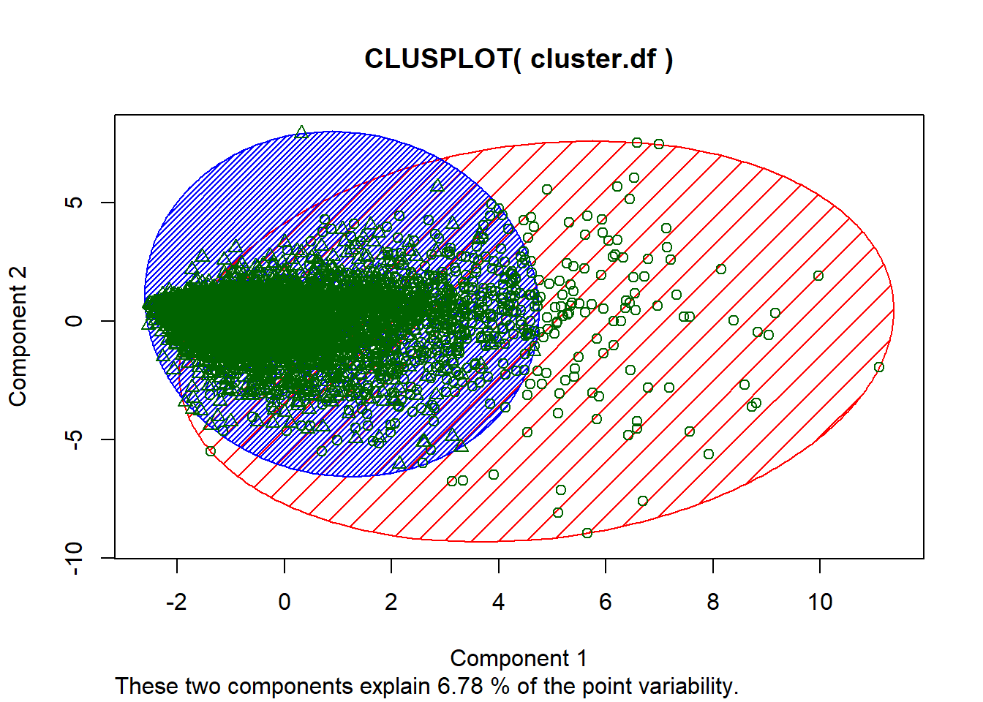
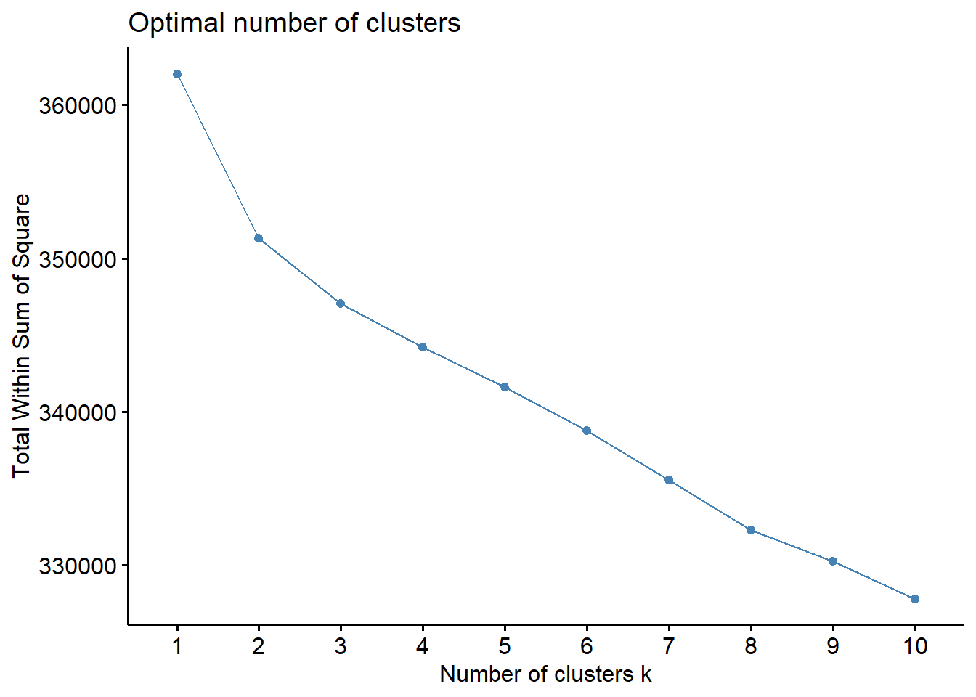
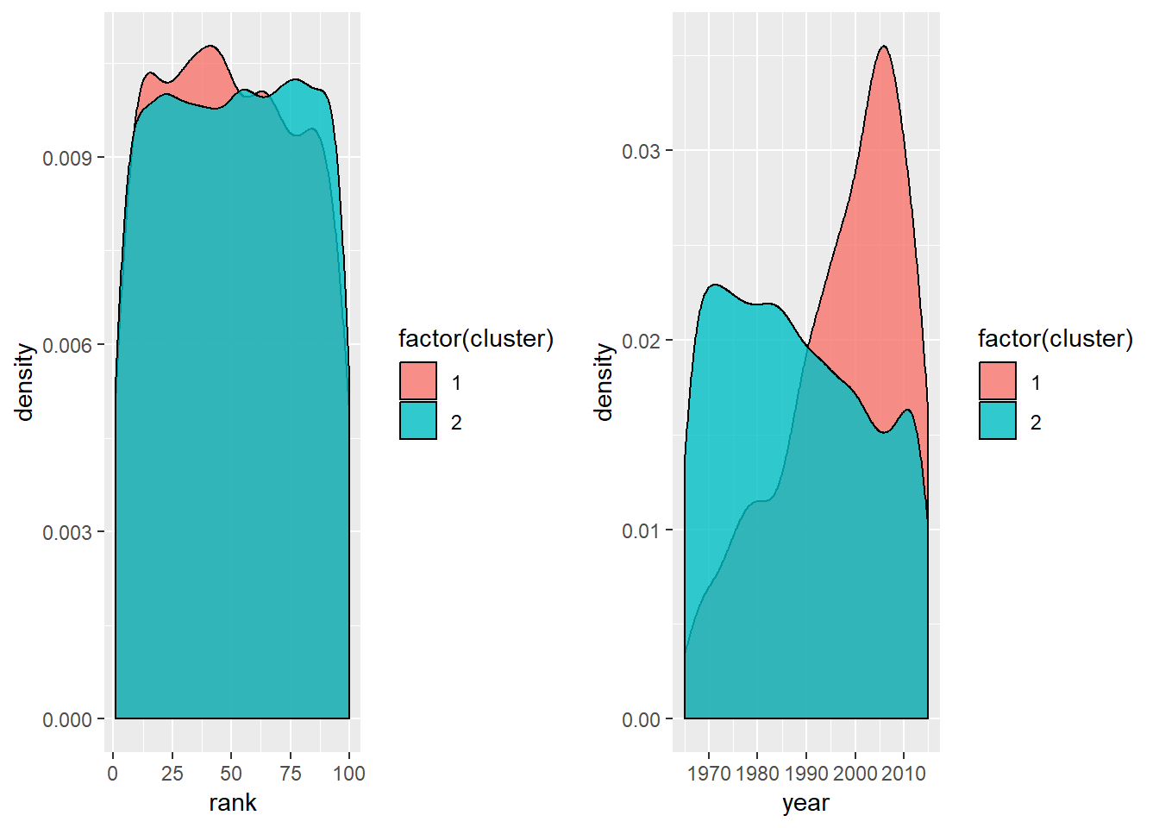
Lyrics Cluster - 2

Slide 17
Predict - Lyrics Logit
Best Results
P R E D I C T E D | 5 Years Actual
 |  | Top 10 No | Top10 Yes
 | No | 88 | 9
 | Yes | 11 | 1
P R E D I C T E D | 7 Years Actual
 |  | Top 10 No | Top10 Yes
 | No | 88 | 8
 | Yes | 2 | 2
Three Logit Models were Conducted with Different Training Dataset.
Past 5 years
Past 7 years
Past 10 years
P R E D I C T E D | 10 Years Actual
 |  | No | Yes
 | No | 88 | 10
 | Yes | 2 | 0

